Slide 1
Error Handling

Slide 2
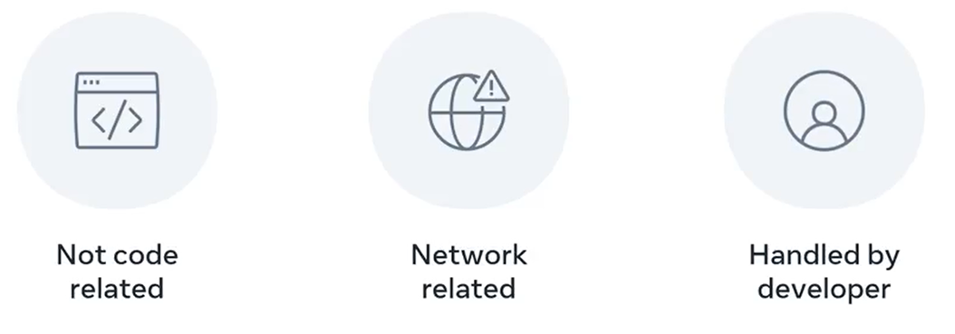

Slide 3
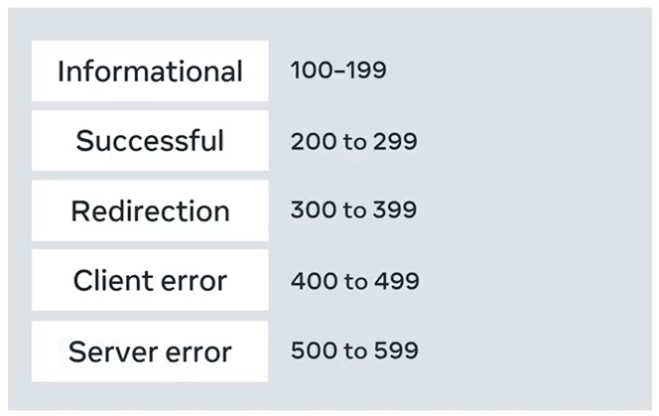

Slide 4


Slide 5
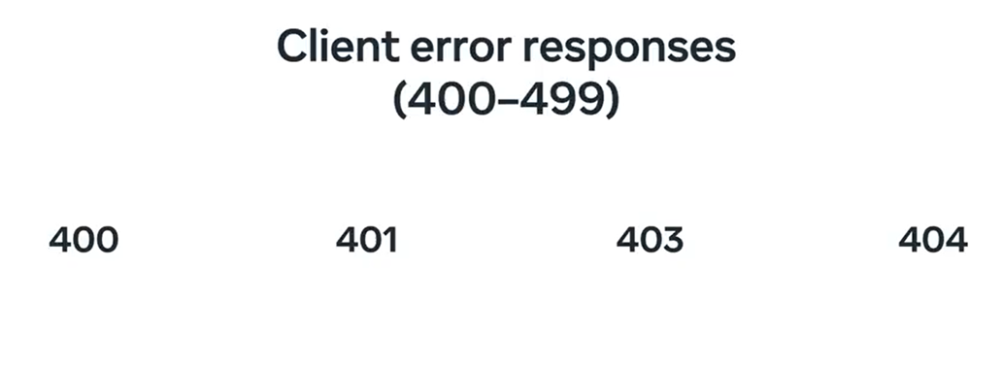

Slide 6


Slide 7
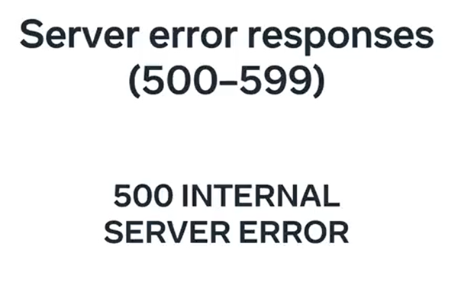

Slide 8
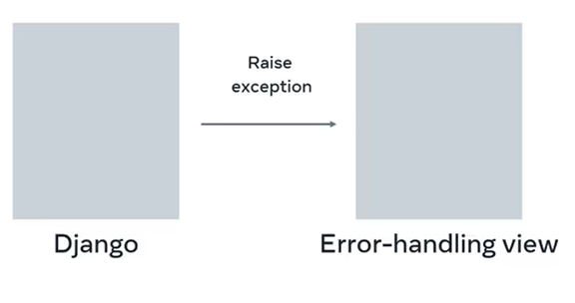
Error handling

Slide 9
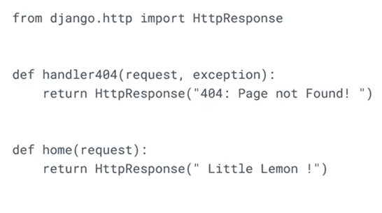
Views.py (project)

Slide 10
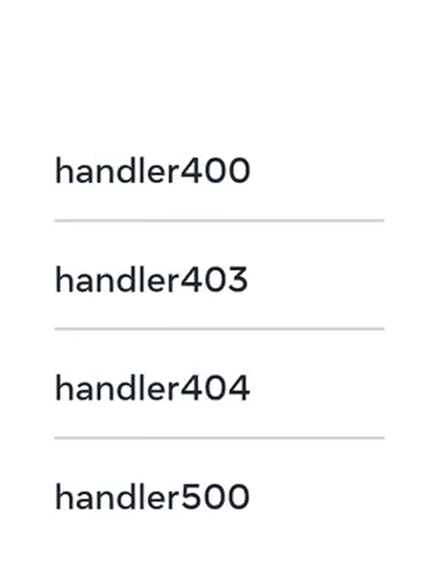

Slide 11

Urls.py (project)
Full Python import path to the view

Slide 12
handler400

Slide 13

handler403

Slide 14
handler404

Slide 15
handler500

Slide 16
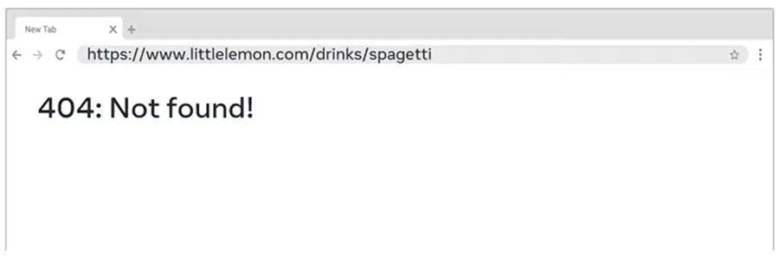

Slide 17
